Slide 1
Week 11 & 12
DSC 640
Abed Tabbalat

Slide 2
Python

Slide 3

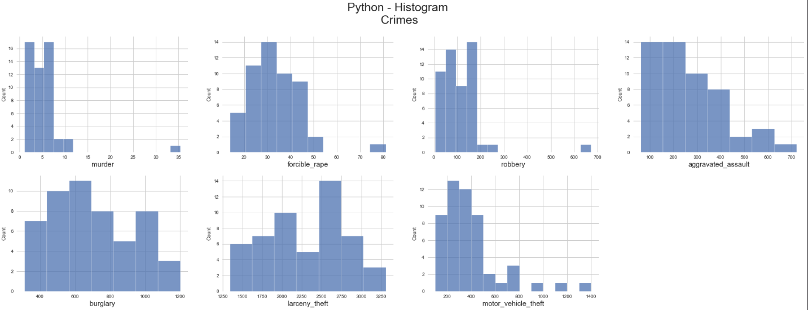
Python – Histogram

Slide 4
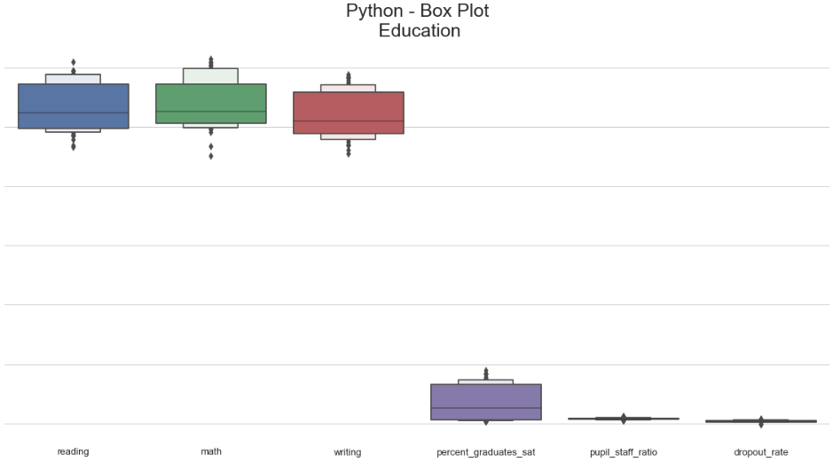
Python – Box Plot

Slide 5
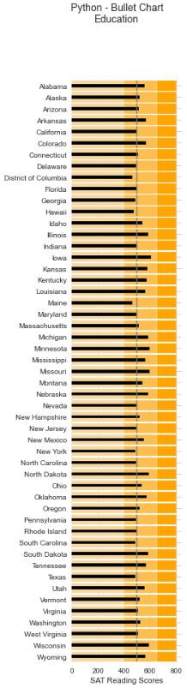
Python – Bullet Chart

Slide 6
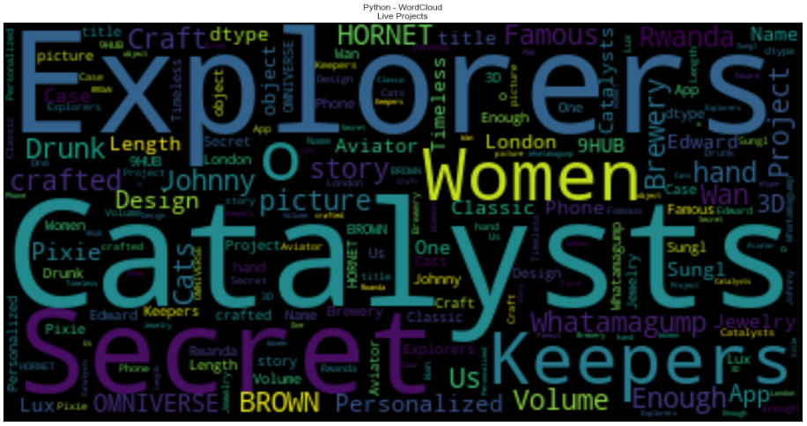
Python – Word Cloud

Slide 7
R

Slide 8
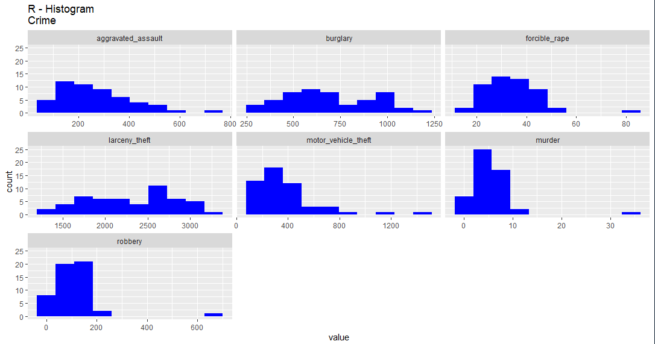
R – Histogram

Slide 9
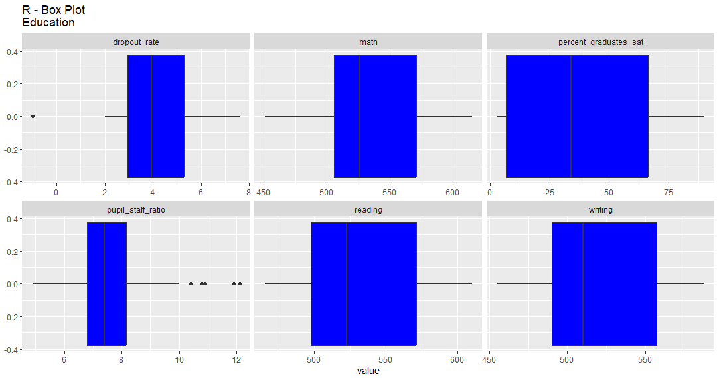
r – Box Plot

Slide 10
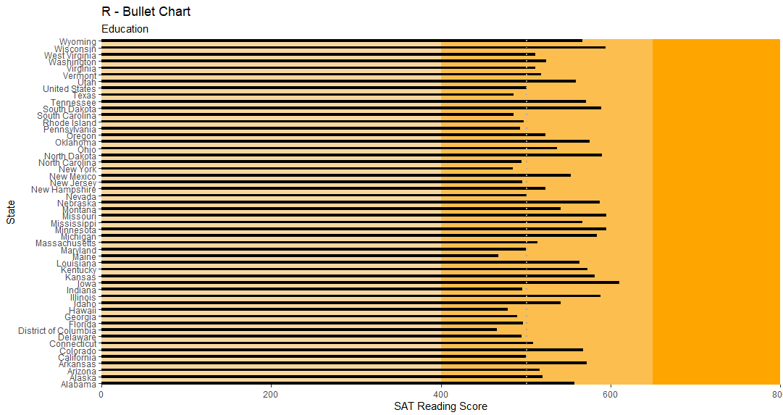
r – Contour chart

Slide 11

r – Word Cloud

Slide 12
Tableau

Slide 13
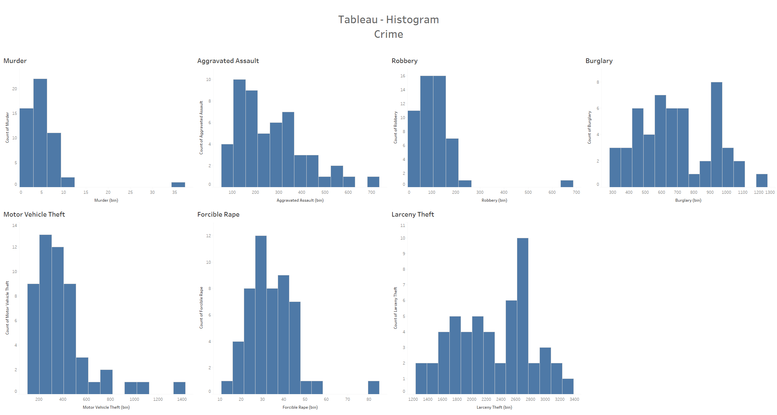
Tableau – Histogram

Slide 14
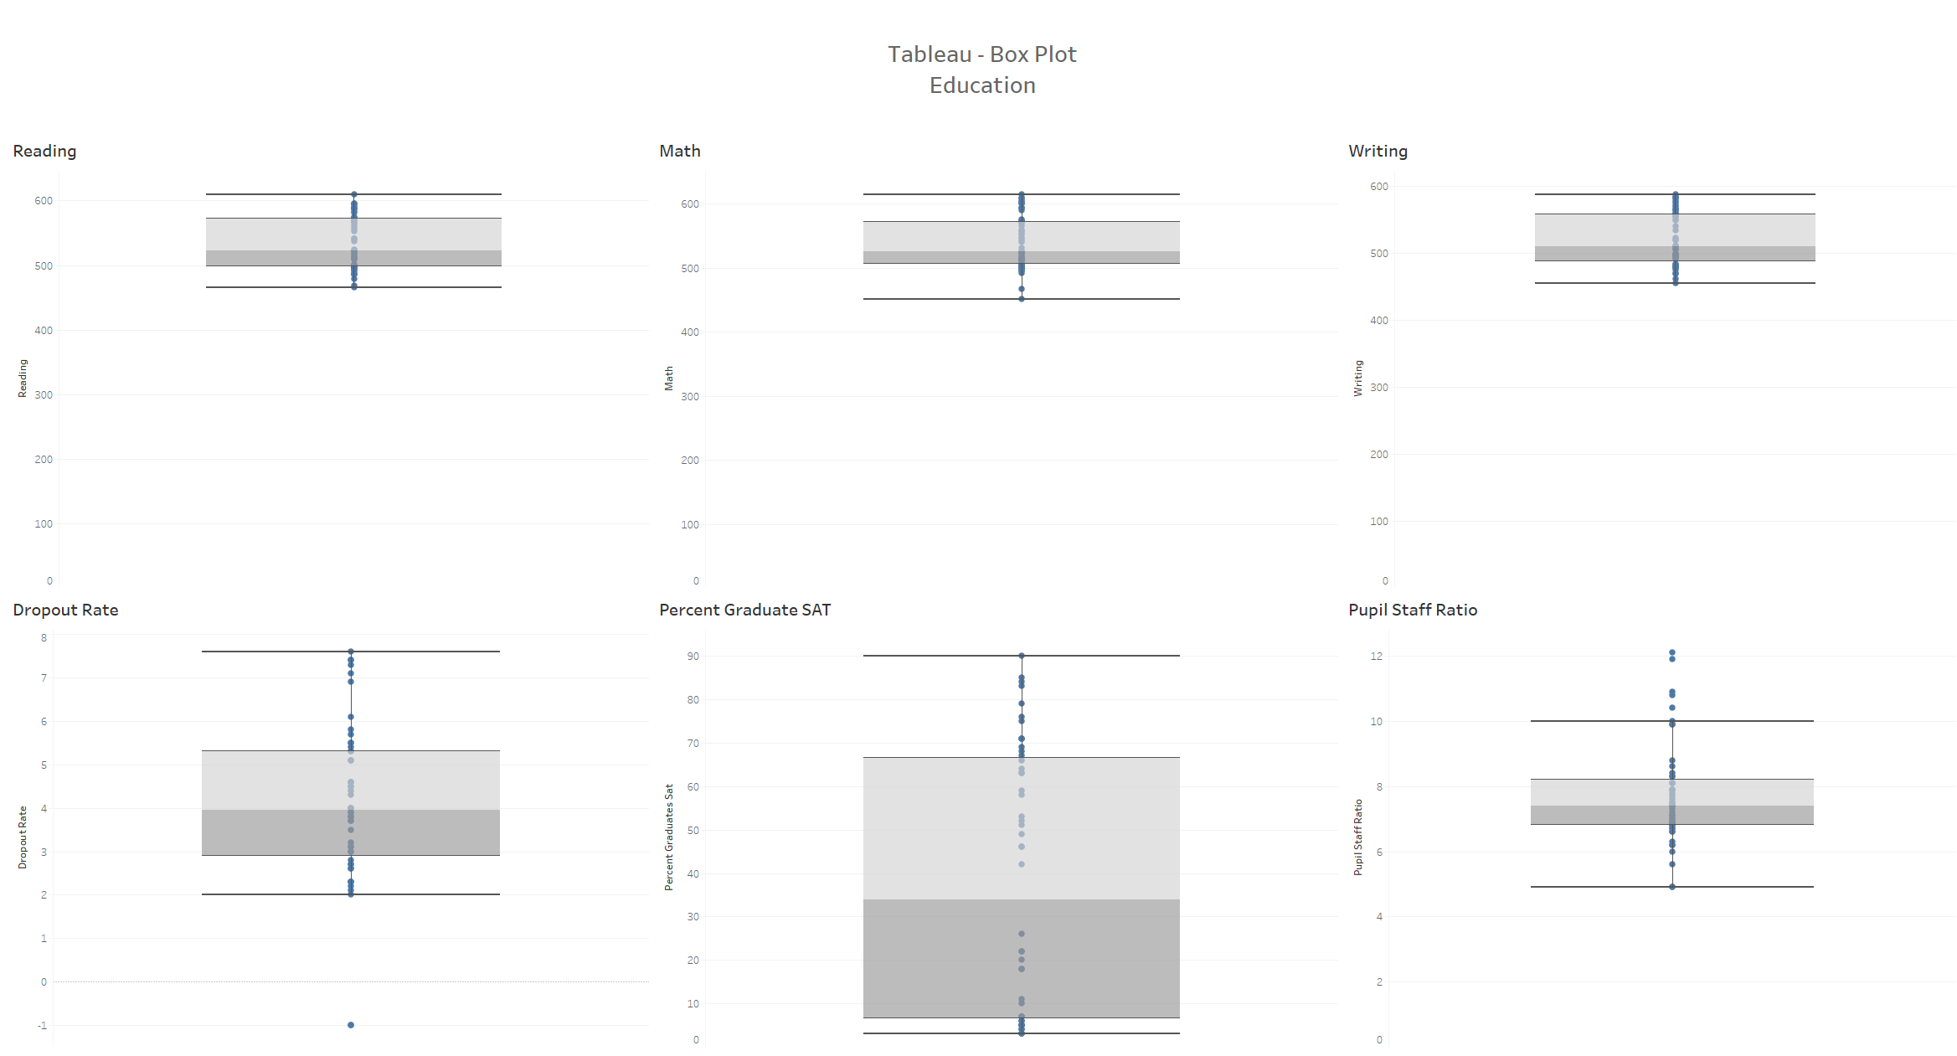
Tableau – Box Plot

Slide 15
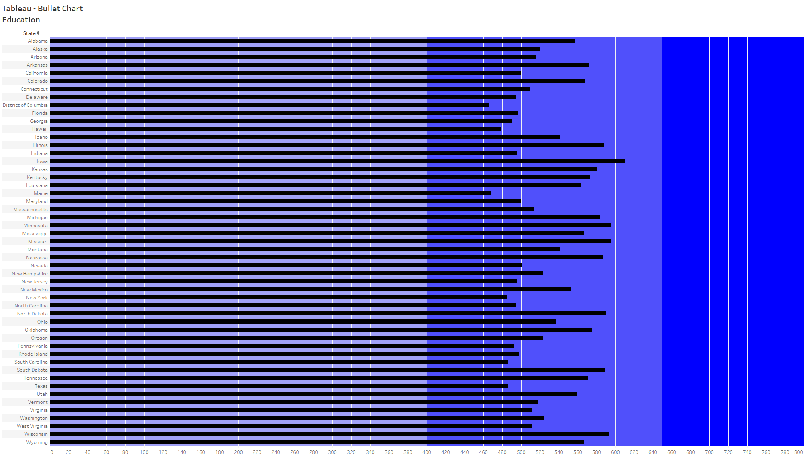
Tableau – Bullet Chart

